Slide 1

Team name: Pratibimb
Team leader name: Bhupinder Singh Chawla
Problem Statement: Making Digital Content Accessible!

Slide 2
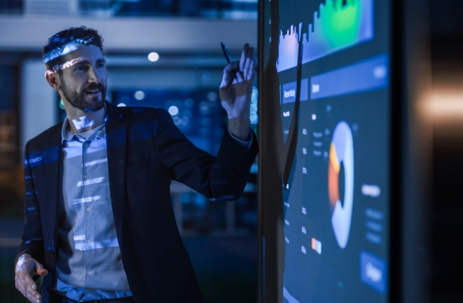

AGENDA
1
Problem Statement
2
Our Vision & Solution
3
USP of our Solution
4
Solution Validation
5
Future Roadmap

Slide 3
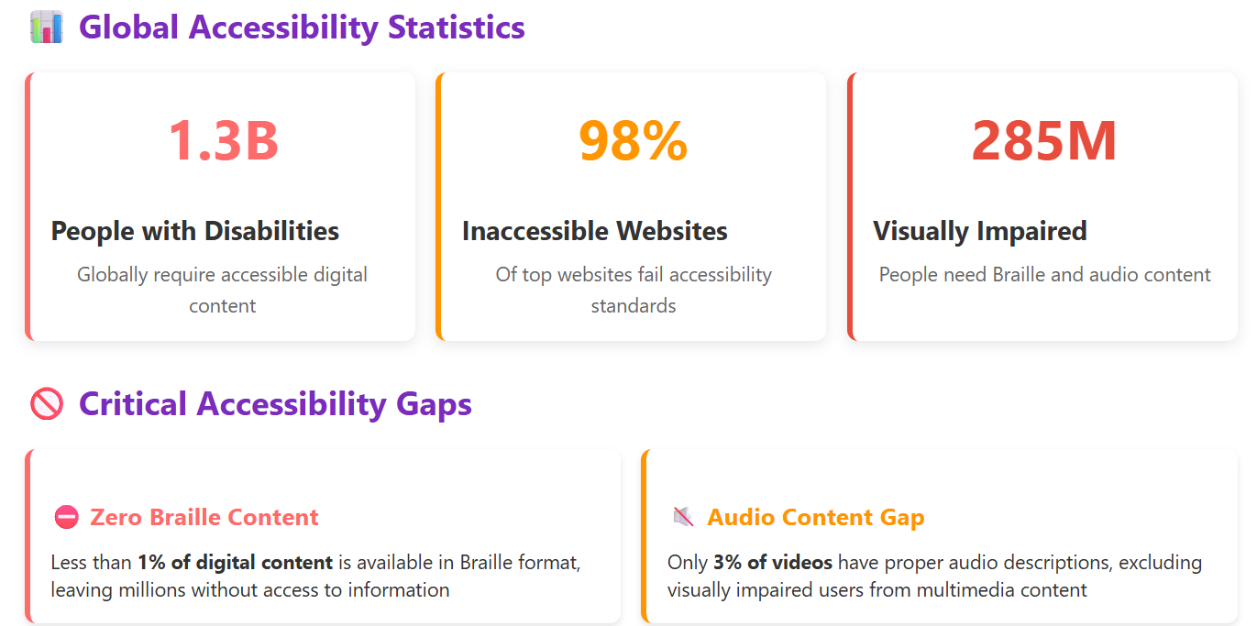

Slide 4
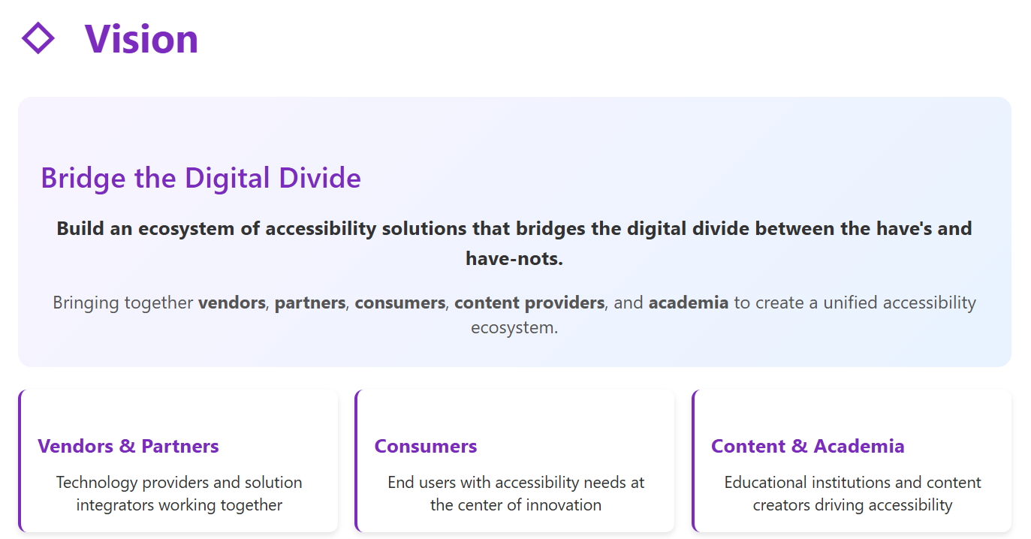

Slide 5
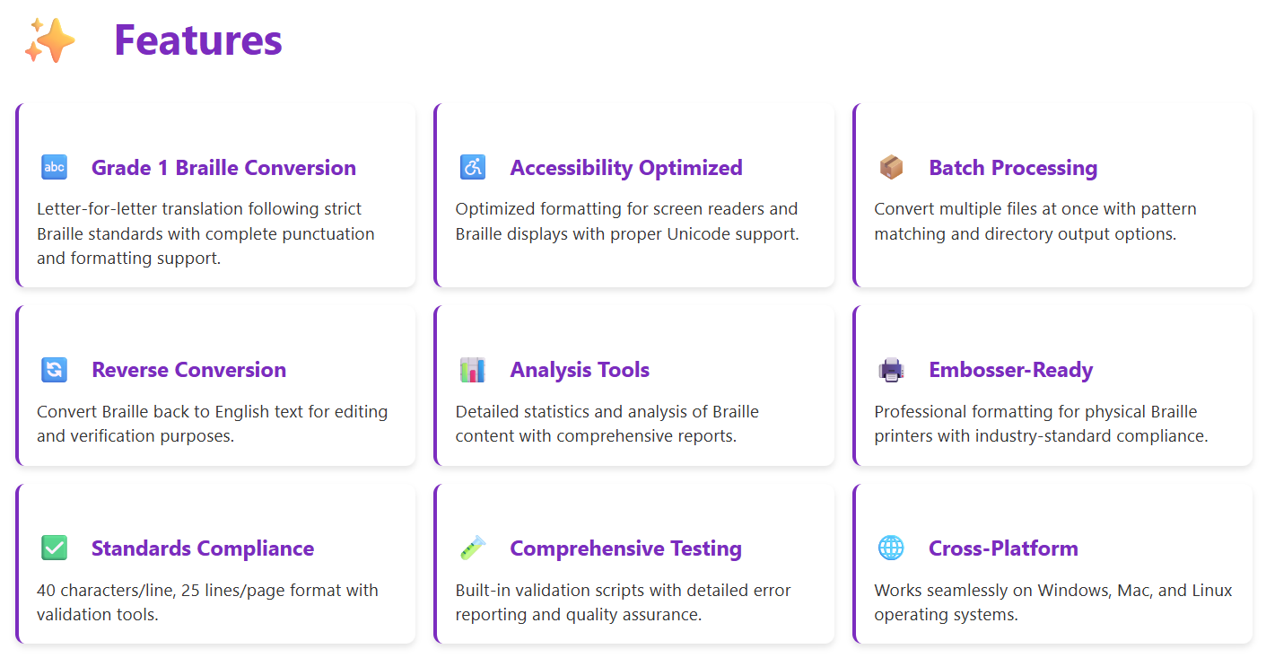

Slide 6
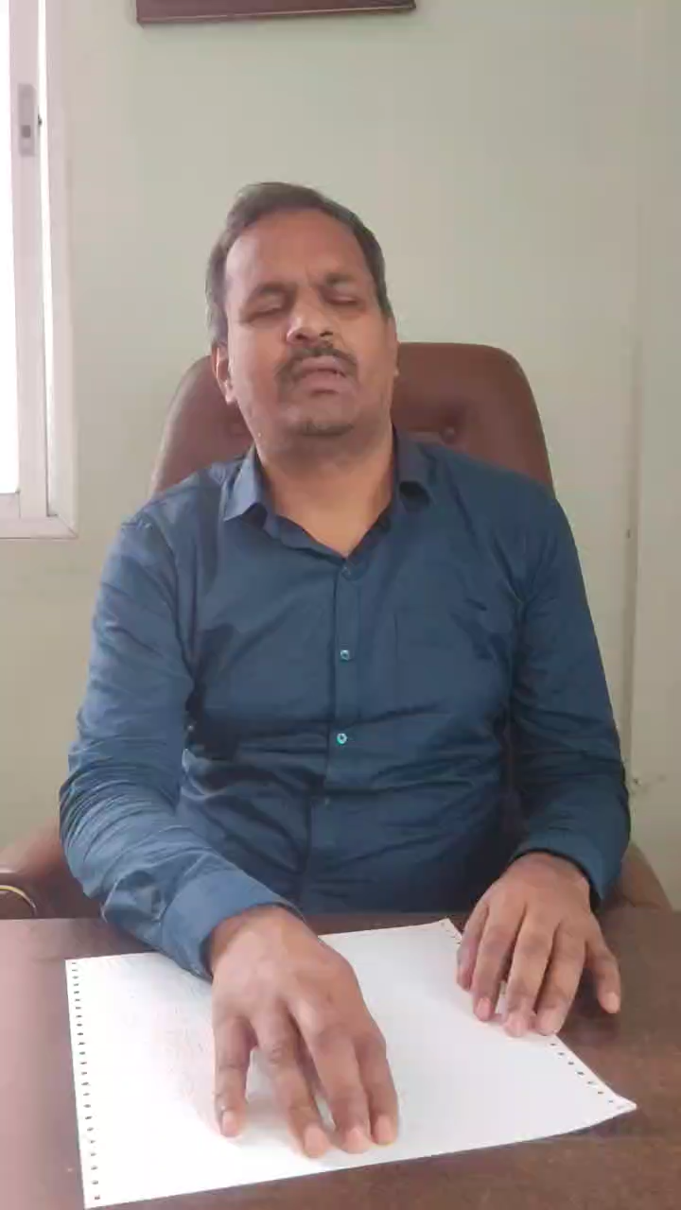
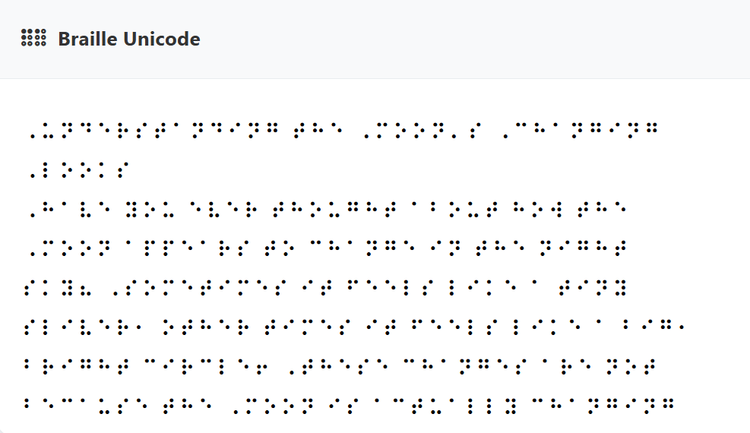
Production readiness approved by actual user today!

Slide 7

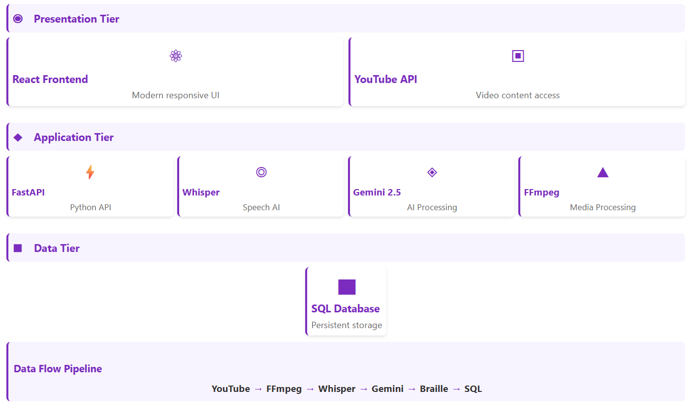

Slide 8
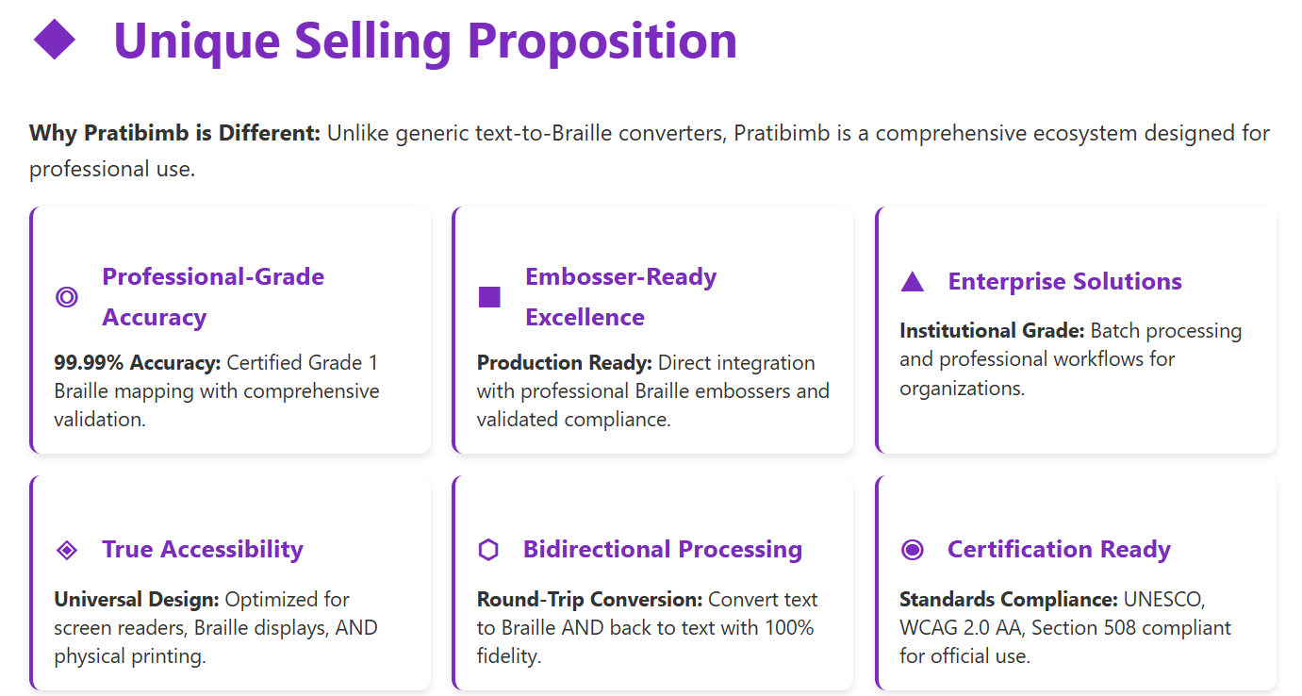

Slide 9
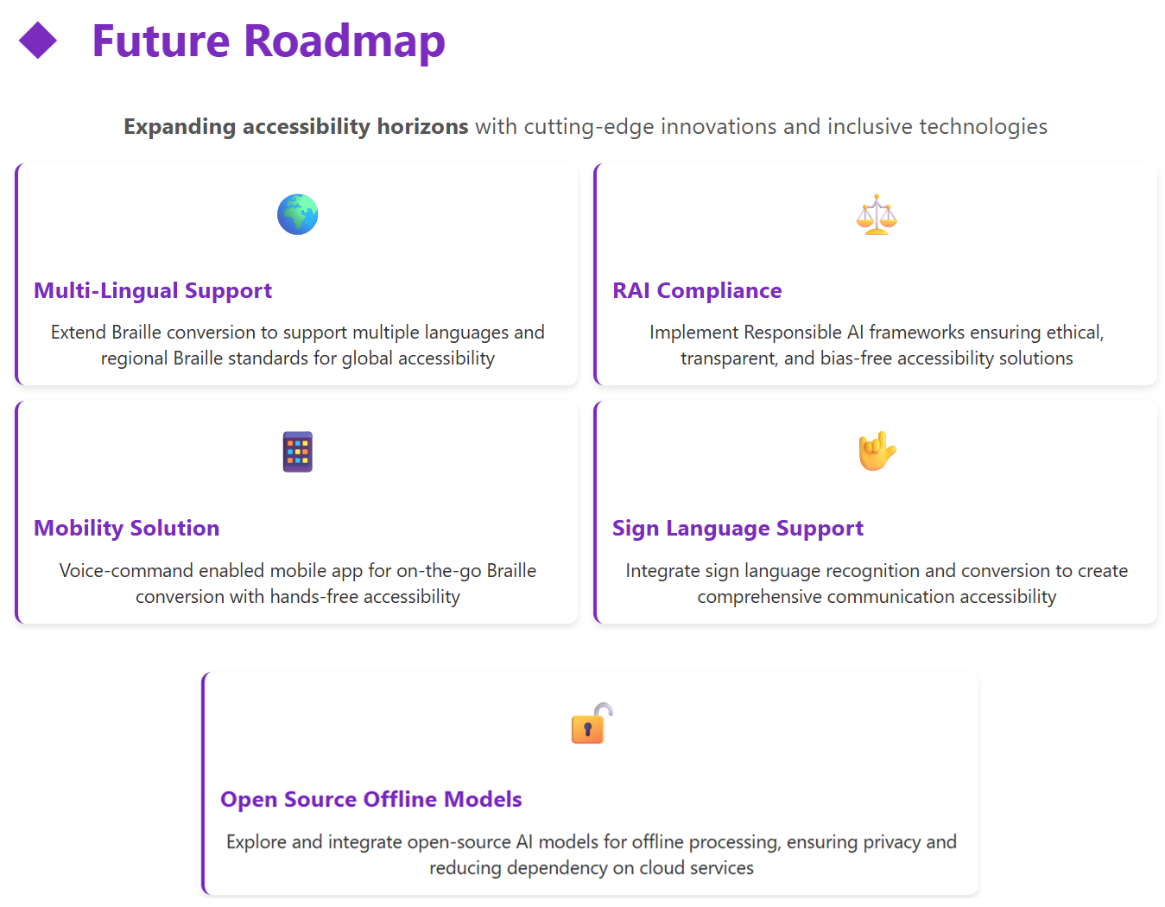

Slide 10

Truly Open Source…Download Now!

Slide 11
Appendix

Slide 12
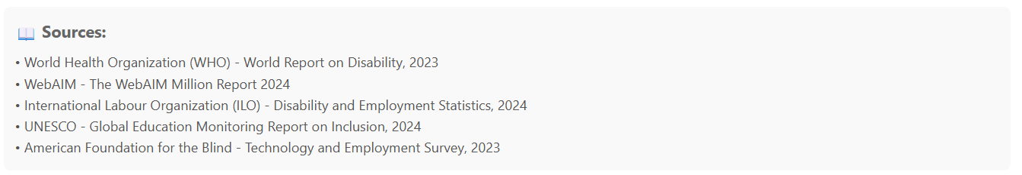

Slide 13
